Slide 1
Final Presentation – PID Switching
Yi Chen

Slide 2
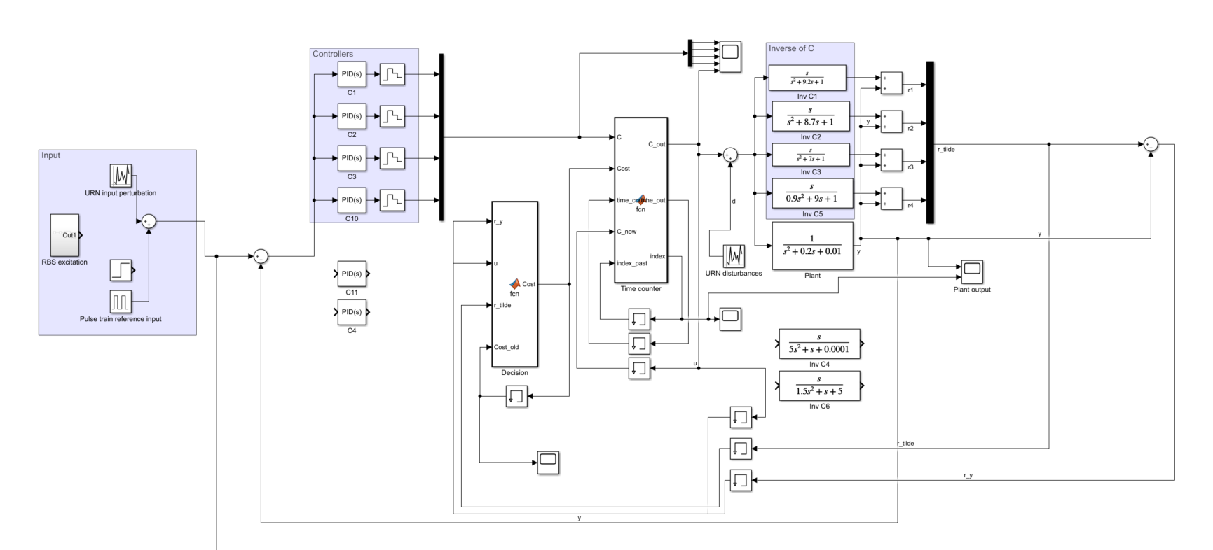
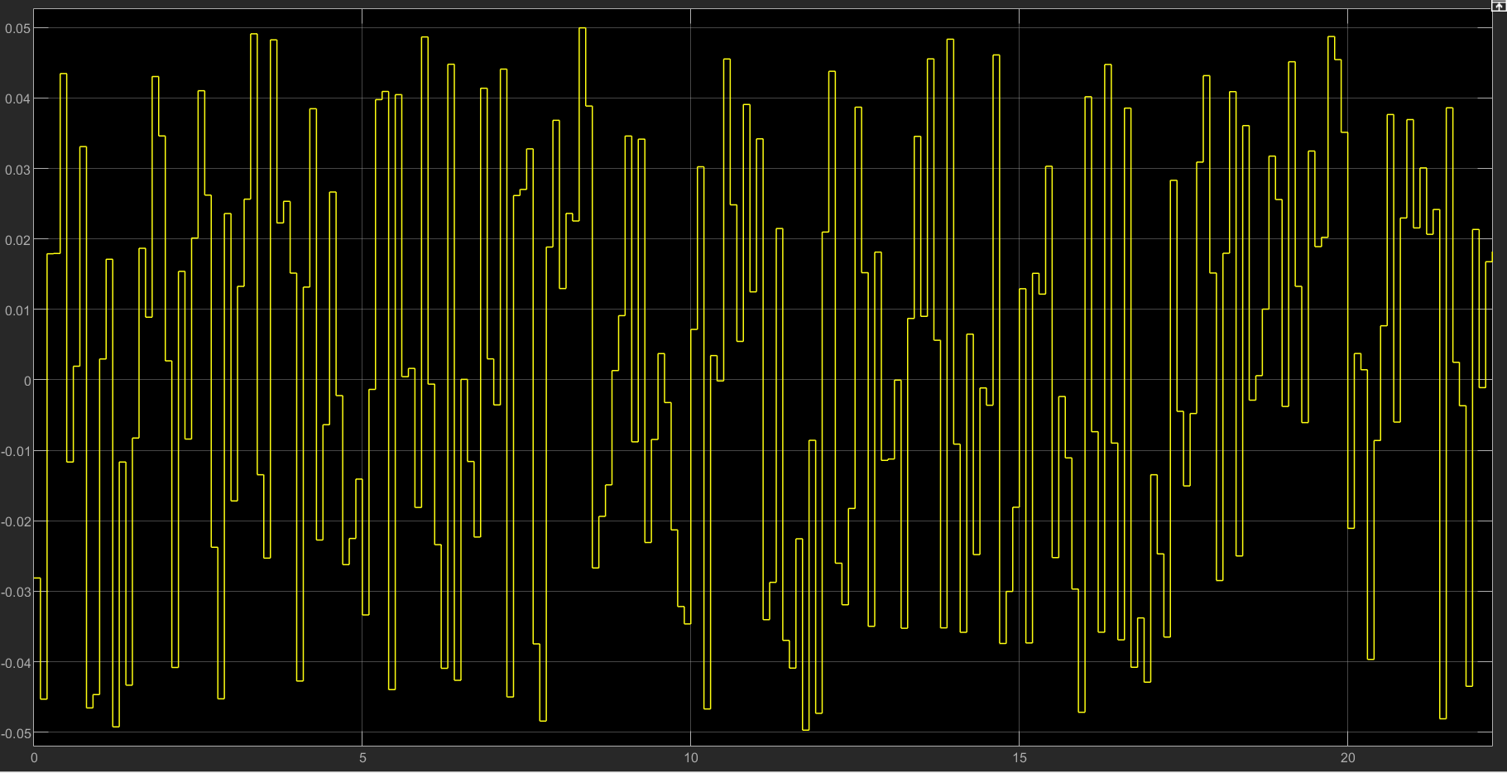
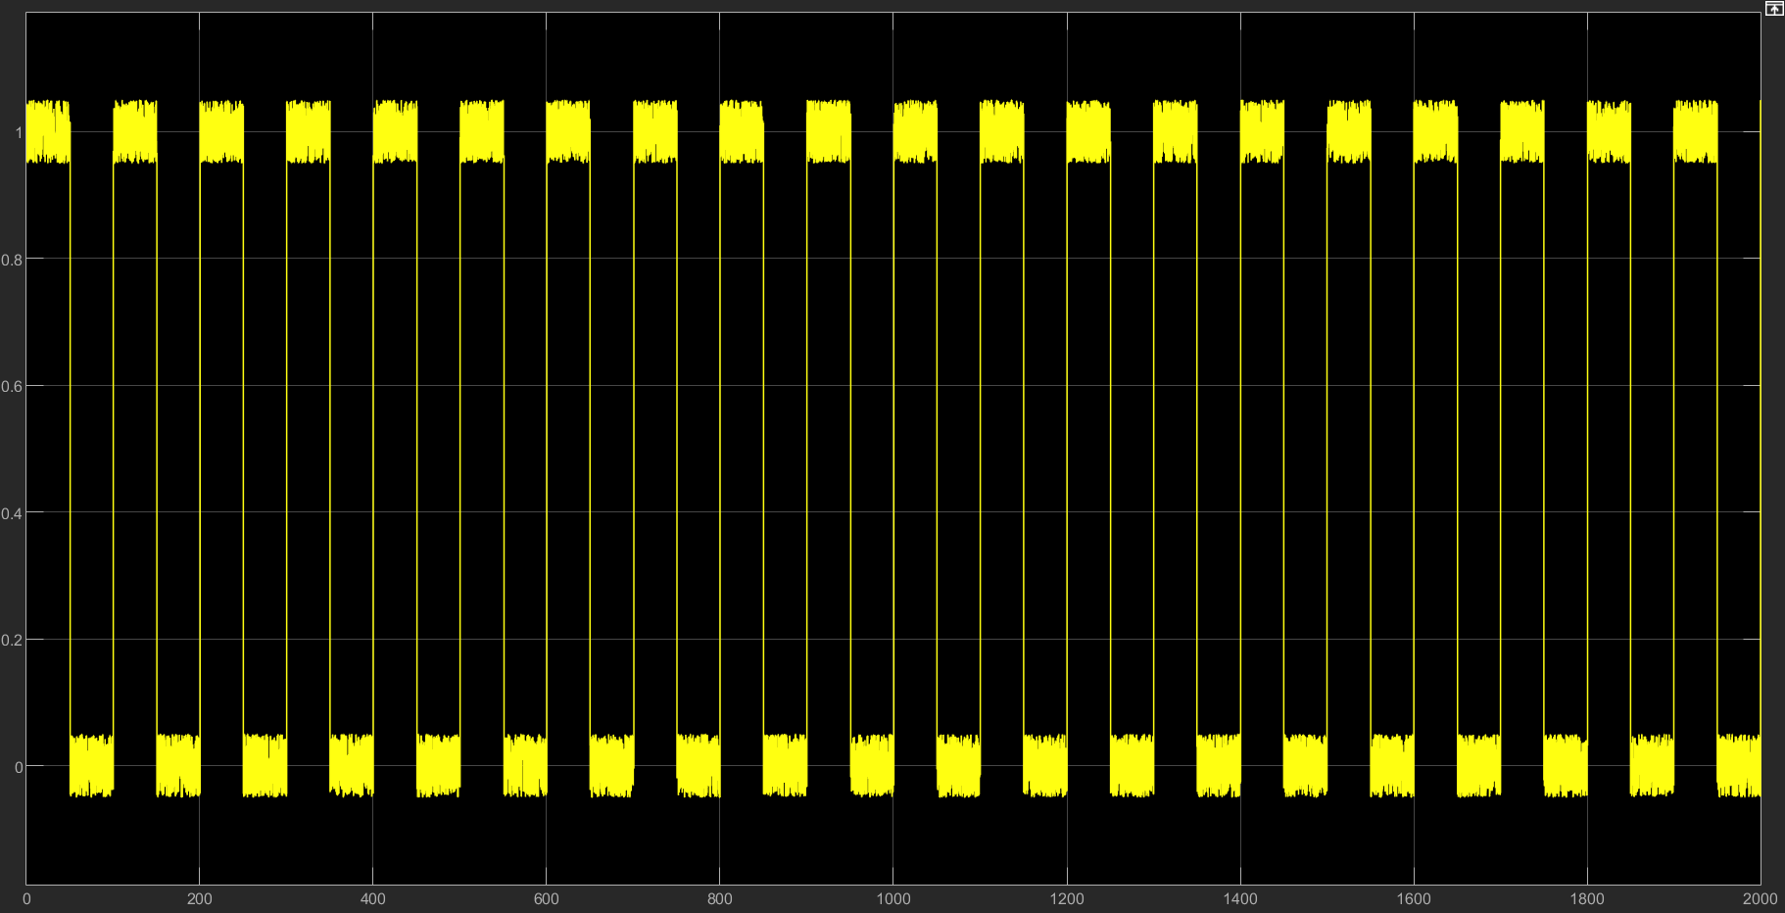
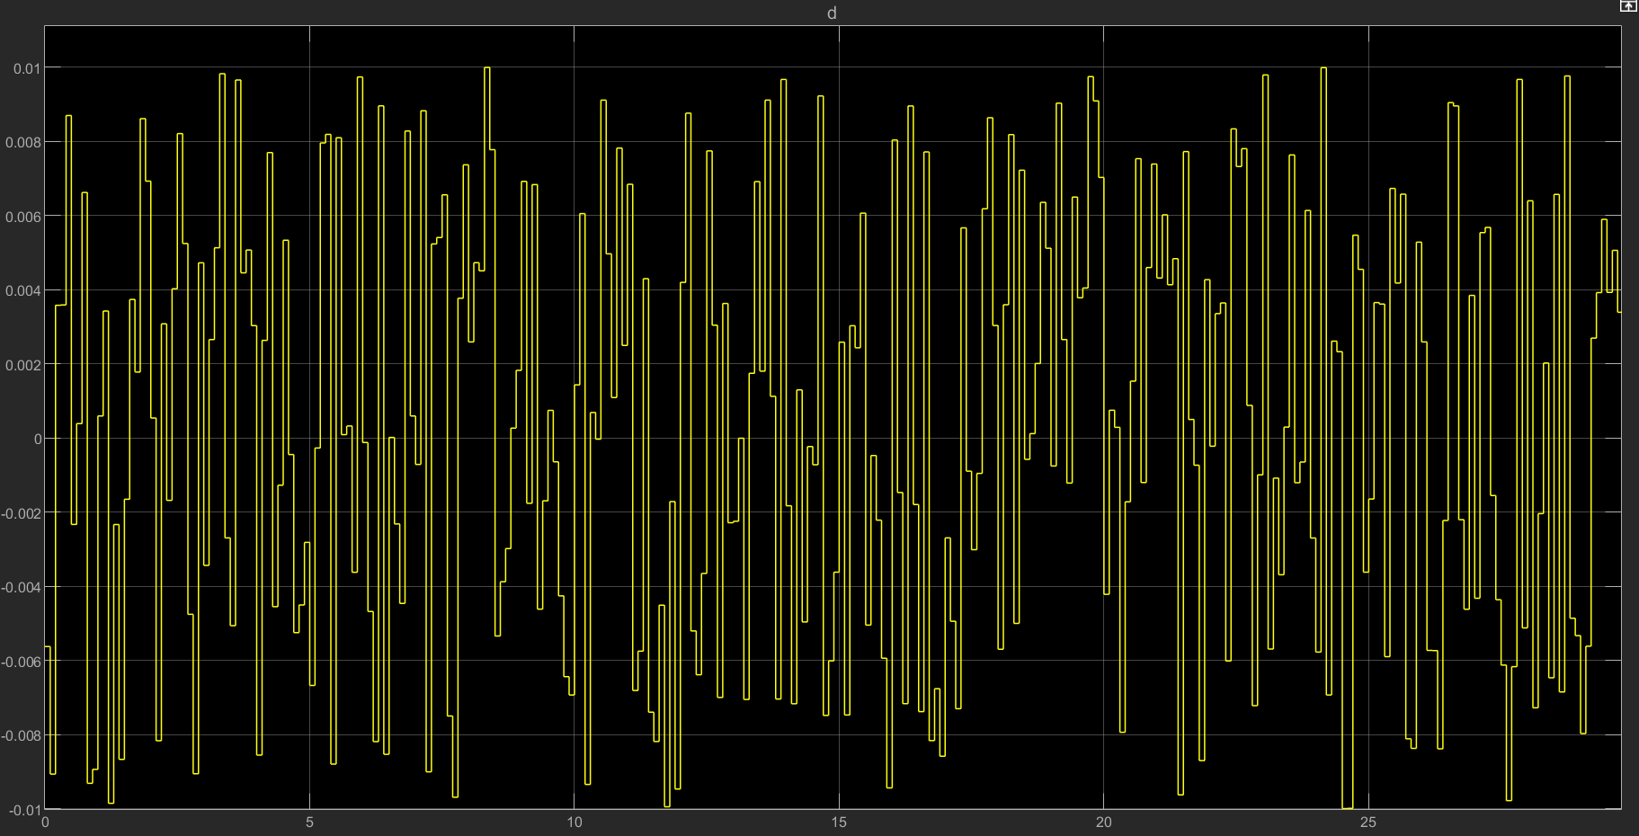

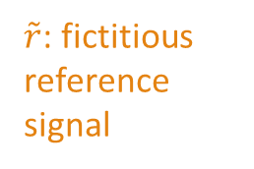
System Setup
Inverse of PID controller
Objective: design a good tracking controller to the reference input for plant 1
$$\tilde{r}=C_{i}^{−1}u+y$$
$\tilde{r}$: fictitious reference signal
Input perturbation
Cost function
Time counter and switching
Reference input: period = 100s
disturbance

Slide 3
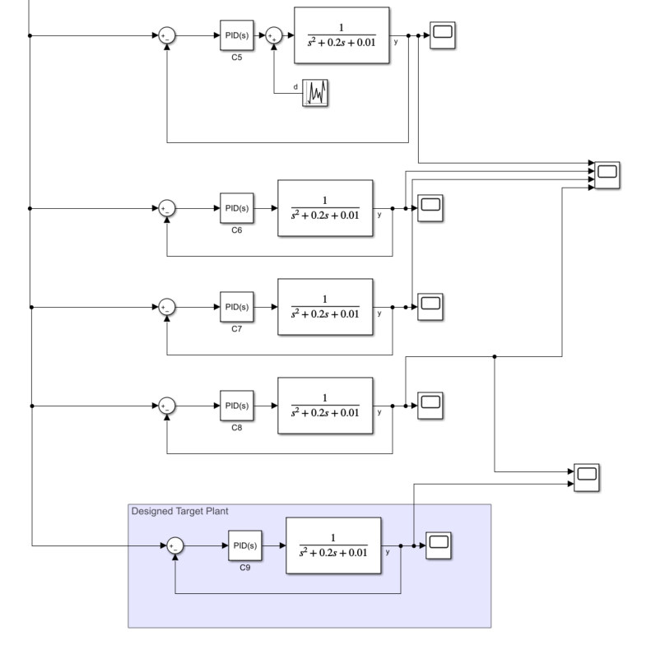
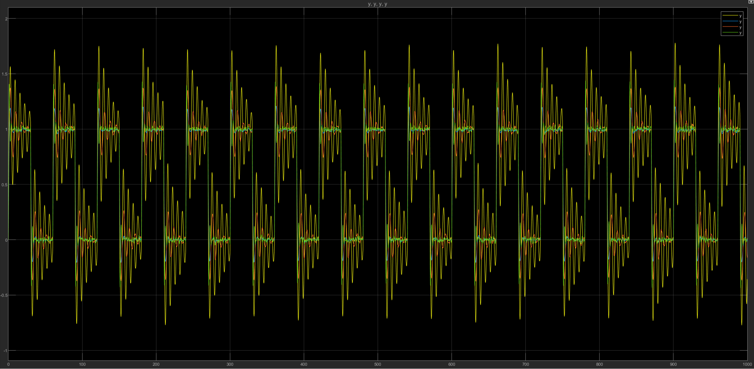
Designing PID
First, we select a more suited PID controller by testing fixed system
Then, controllers with similar parameters are integrated into the adaptive system
Final design: Ci = [kp ki kd]
C1: [10 1 1]
C2: [8 1 1]
C3: [7 1 1]
C4: [9 1 0.9]

Slide 4
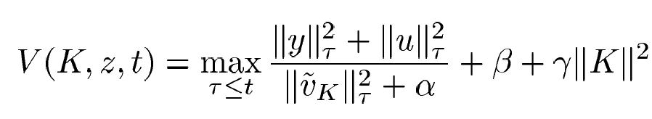

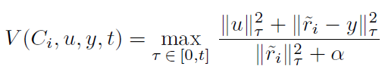
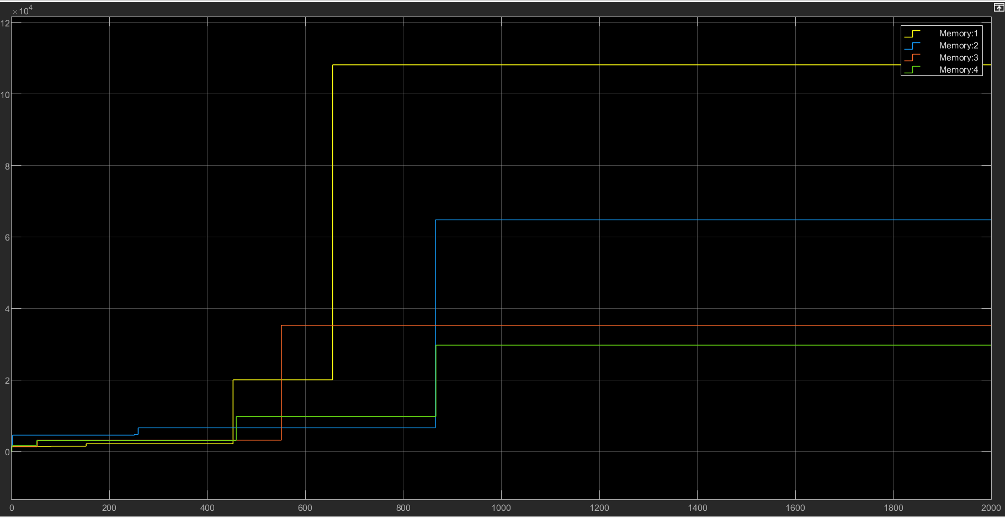
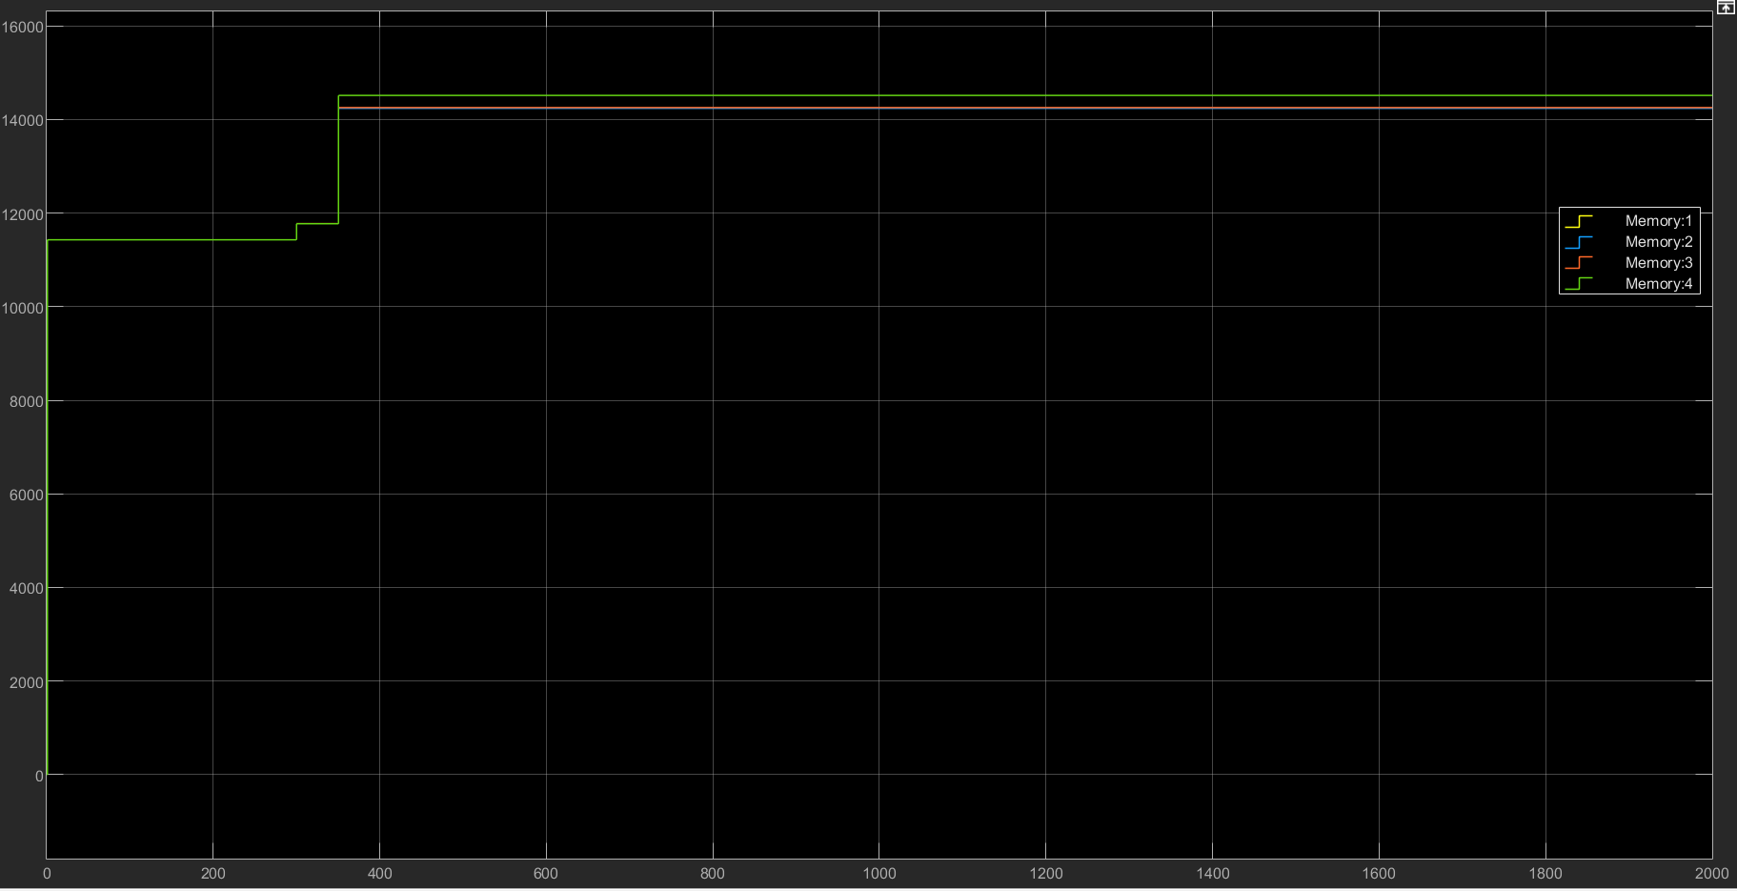
Cost function selection
u and error signal e should be small compare to command signal r
u in this case is a lot bigger than r or e
V = max
W1 = 0.00001
W2 = 1
a = 1

Slide 5
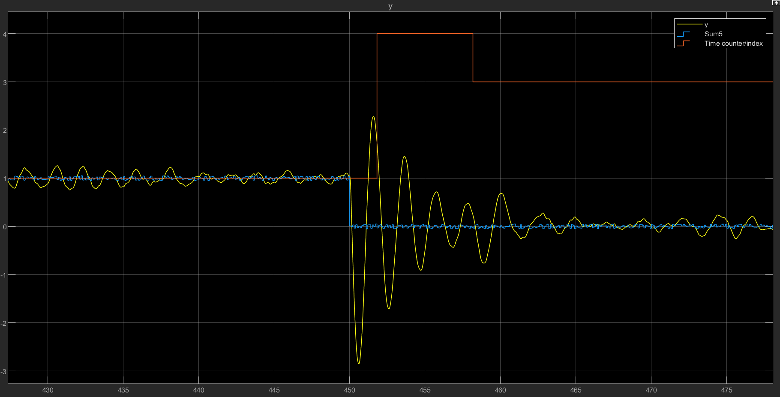
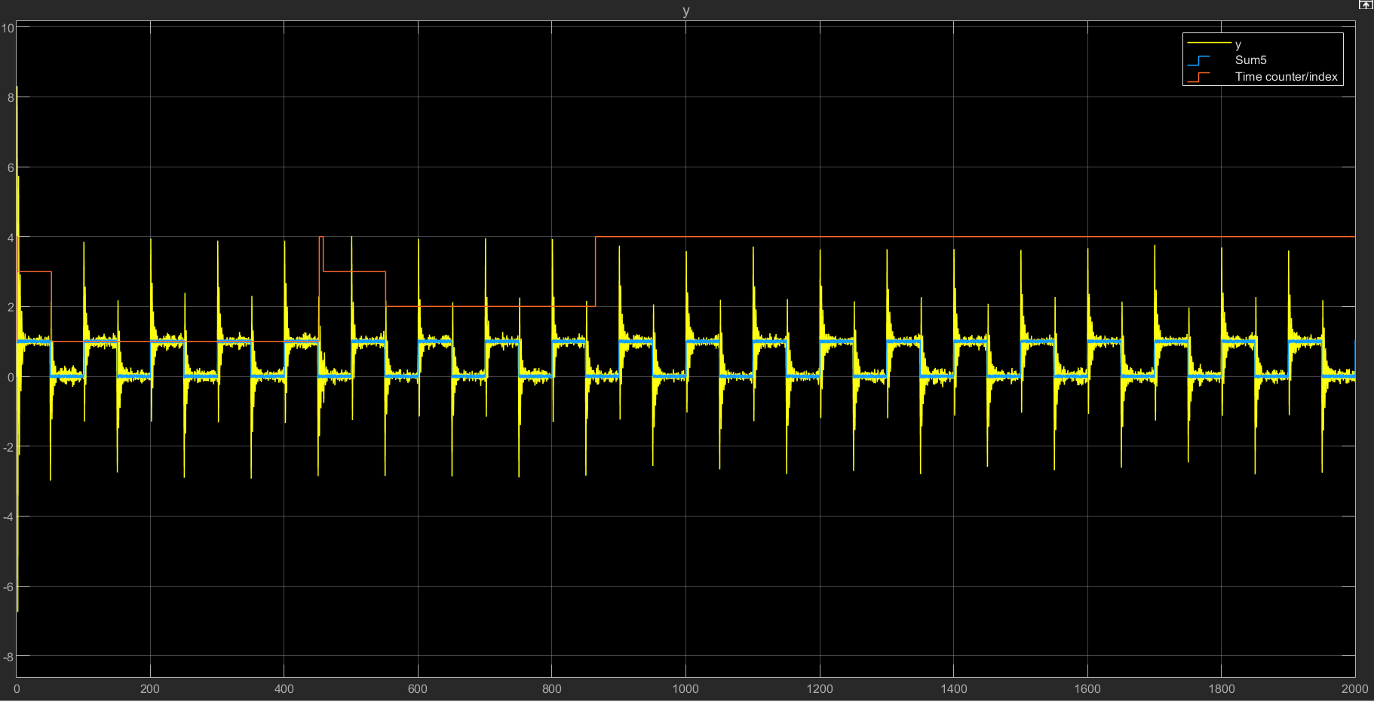
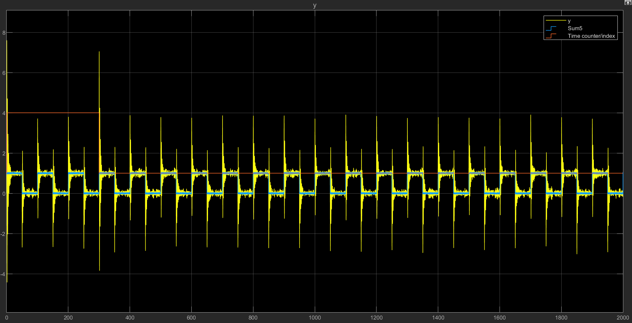
Cost function comparison in system output
Cost function on the left does a better job on reflecting controller performance and thus giving better system transients.
V = max

Slide 6
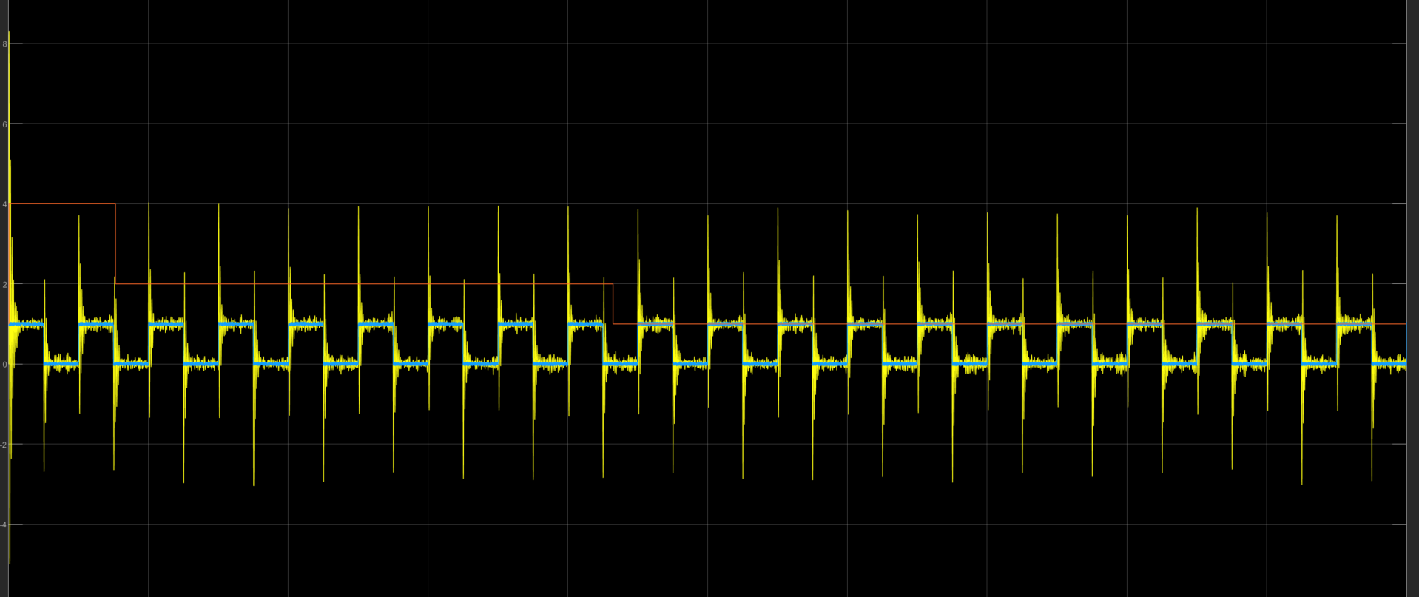
Plant output
In this case, all controllers are similar, so the transients are relatively minimal.
Ideally we need to smooth out the input signals during the switching phase.
Dwell-time = 1
Blue: reference input
Yellow: plant output
Orange: controller in use

Slide 7
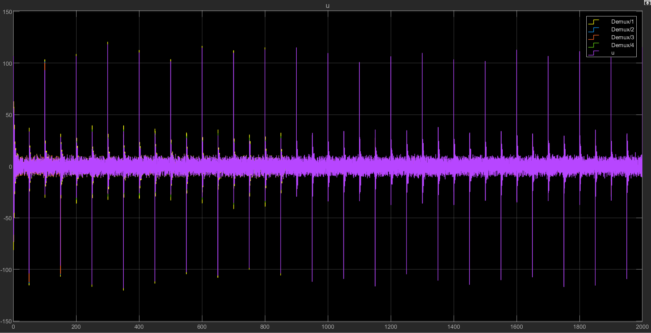
Controller output
Each controller has different response to the. This affects the cost function and causes the system to switch to different controller.

Slide 8
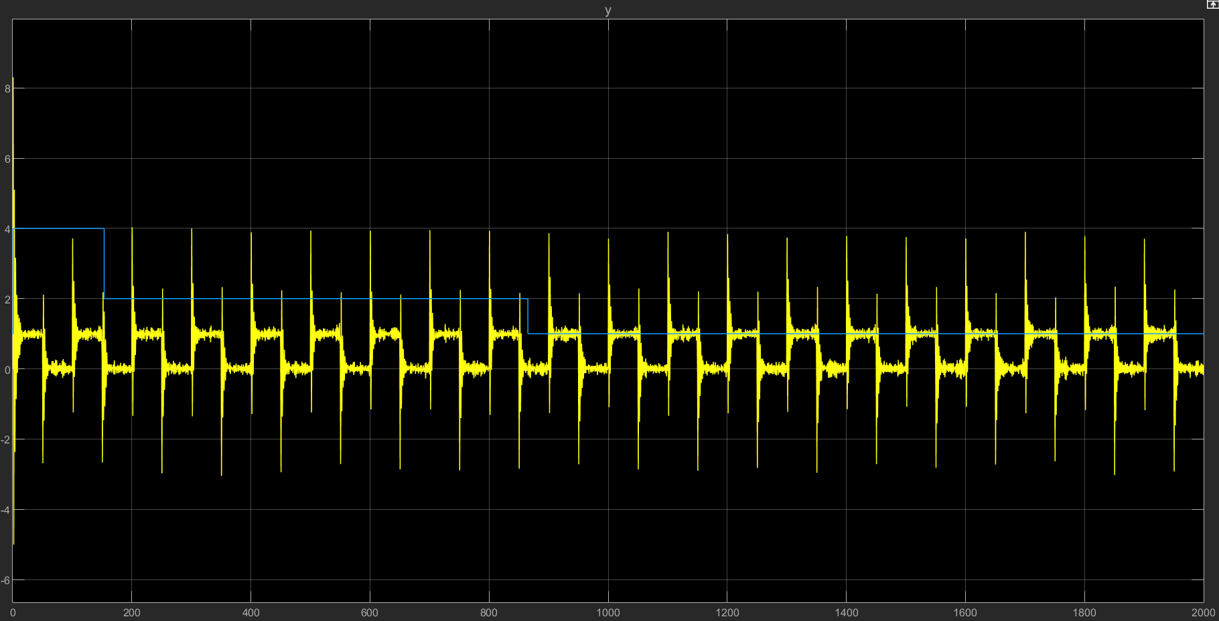
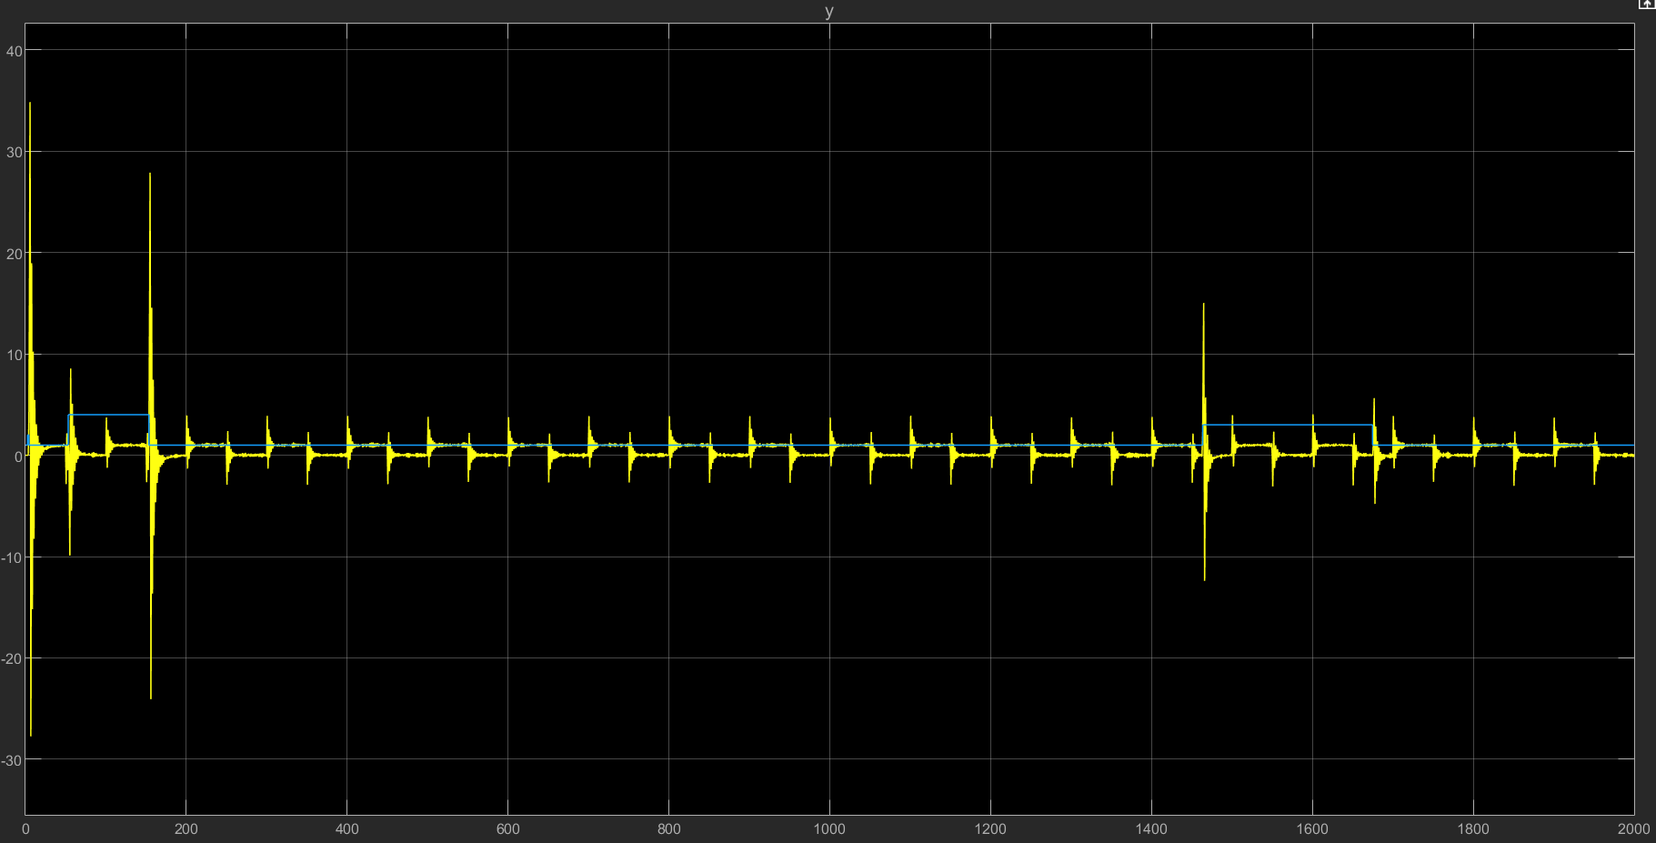
Controller Switching
Dwell-Time | 0.1 | 1 | 3 | 5 | 10
Number of switches | 1 | 3 | 4 | 10 | 7
Switching transients happen if the process of switching is not continuous.
Dwell time is designed to prevent it from switching controllers too fast.
Having long time out can produce the risk of having bad transients (such as selecting a destabilizing controller) as the system is blind-folded for that time period.
Ts = 1
Ts = 10
Switching transients

Slide 9
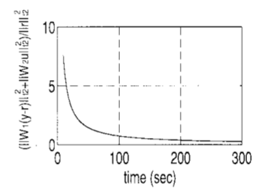
Summary / Discussion
To prevent rapid switching, filtering the cost function was used as proposed in the paper (using max value in the time period)
Using different dwell-time had unexpected effect on the switching algorithm
Using different cost function also had an effect on the system transients, as it alters the way controllers are evaluated
In another paper, the cost value converged to 1. According to the paper it was done through giving proper weights on each signal (i.e., u, e = y- r, r_tilde ).

Slide 10
Reference
[1] Unfalsified Adaptive Control: A New Controller Implementation and Some Remarks
[2] The Unfalsified Control Concept and Learning

